Slide 1
A Load
Of Old
Billhooks
Bob Burgess Heytesbury Wilts
www.billhooks.co.uk

Slide 2
What is a billhook??
A billhook is an edge tool used for cutting green wood or similar materials
They have been around in Britain for over 2000 years
They are found in most European countries and most other countries with a history of iron working
They are found with a wide variety of blade shapes and sizes
They usually consist of a blade made of iron and/or steel with a handle in line with the blade

Slide 3
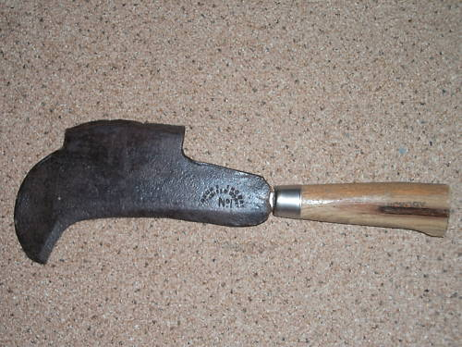
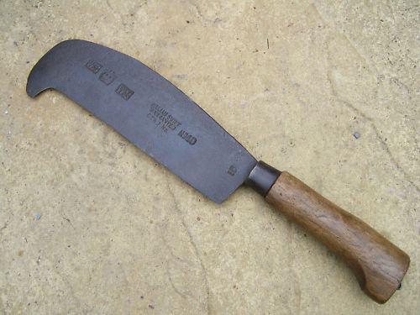
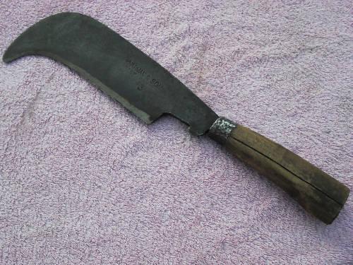
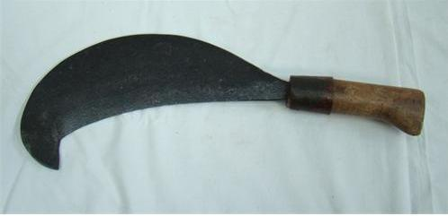
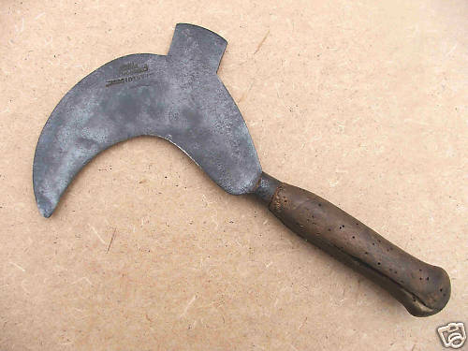
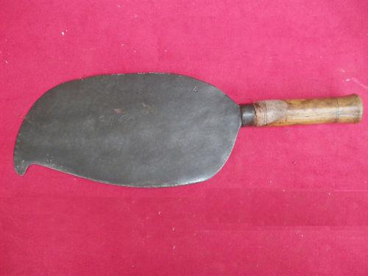
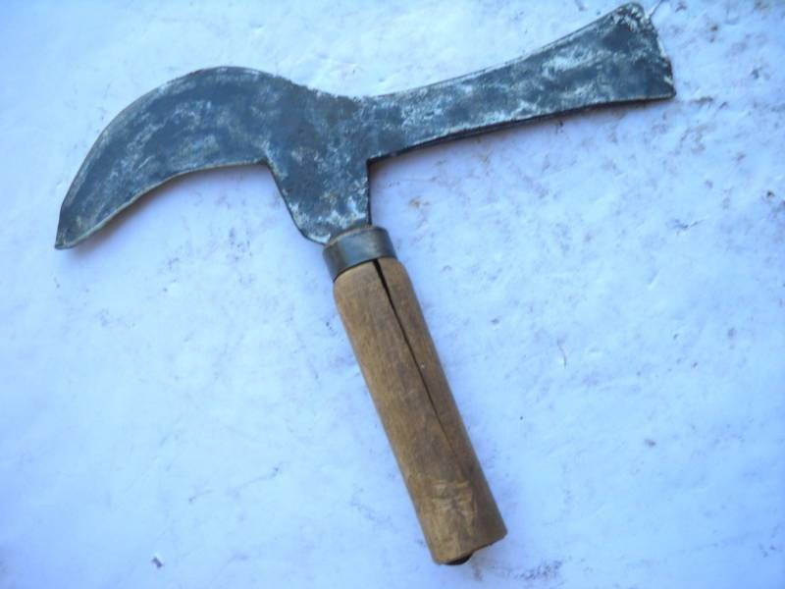
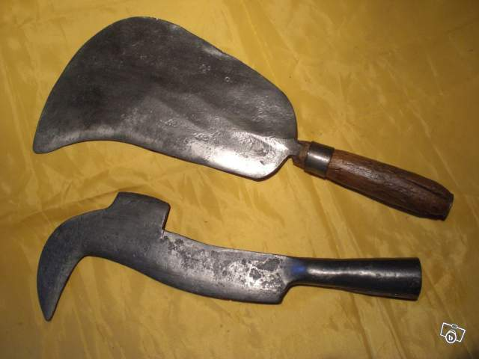
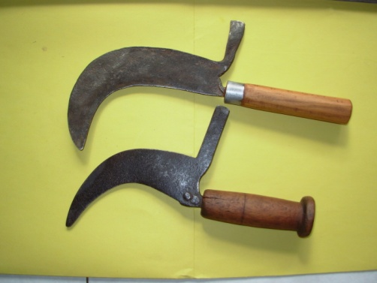
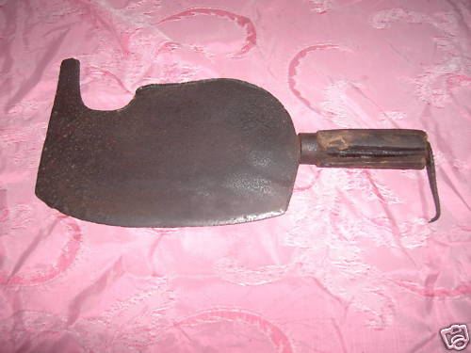
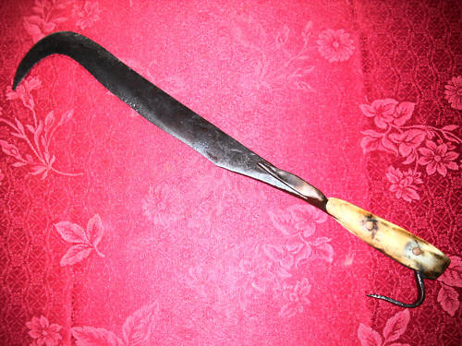
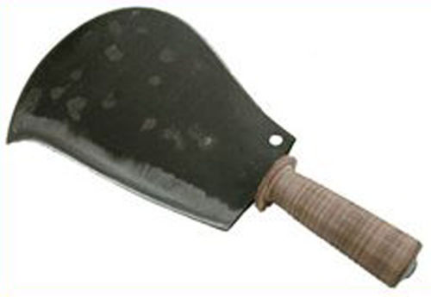
UK
FRANCE
ITALY

Slide 4
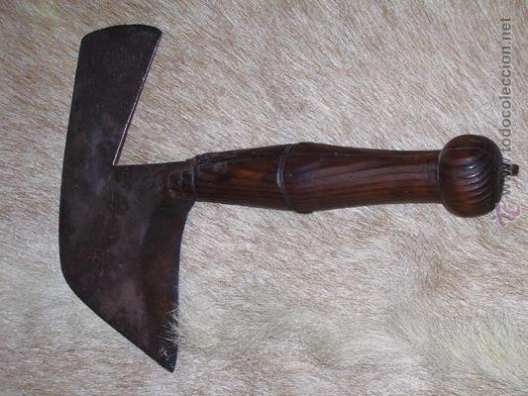
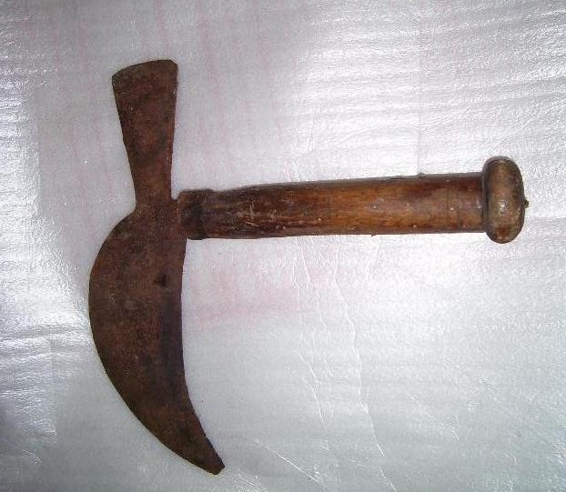
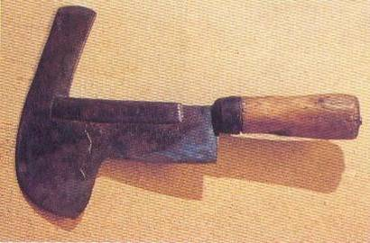
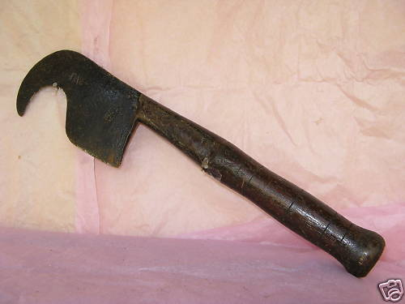
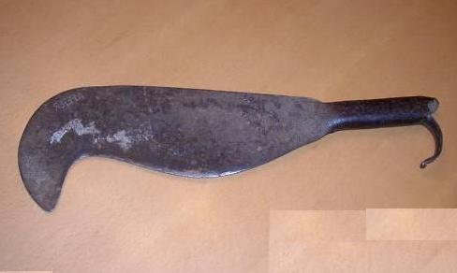
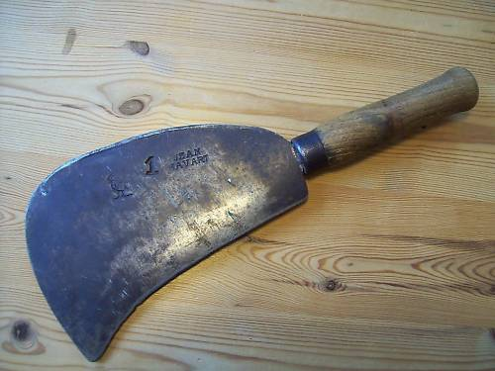
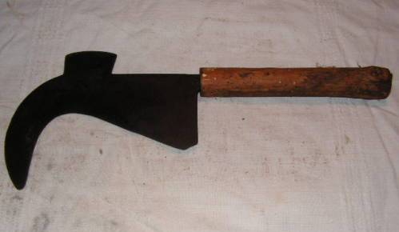
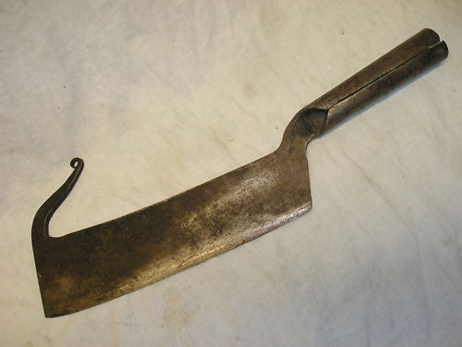
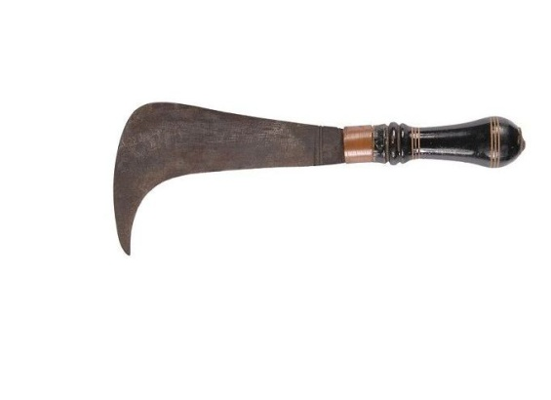
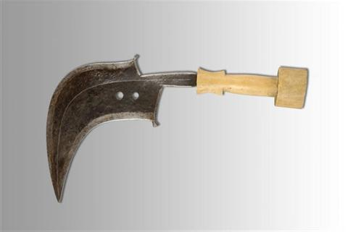
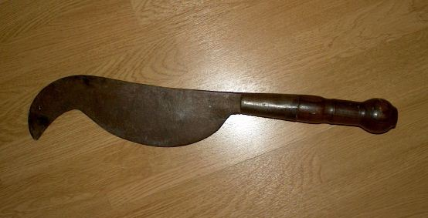
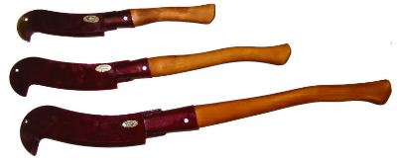
SPAIN
PORTUGAL
GERMANY
HOLLAND
HUNGARY
AUSTRIA
FINLAND
INDIA
JAVA
AFRICA

Slide 5
What is an edge tool??
An edge tool is one that has some sort of cutting or striking edge etc – such as:
Axe
Sickle
Billhook
Wood Chisel
Adze
Drawknife
Plane Blade
Pickaxe
Crowbar
Cold Chisel for metal or stone
Meat Cleavers
Spades, Shovels and Forks

Slide 6
The Edge Tool Maker was a specialist blacksmith who made the tools for most other trades, such as:
Carpenter
Joiner
Woodsman/Forester/Coppice worker
Farmer
Hedger and ditcher
Saddler
Shoemaker
Butcher
Builder
Stone mason
Slate cutter
Gardener
but not cutlery, although in Sheffield many firms made both cutlery and edge tools

Slide 7
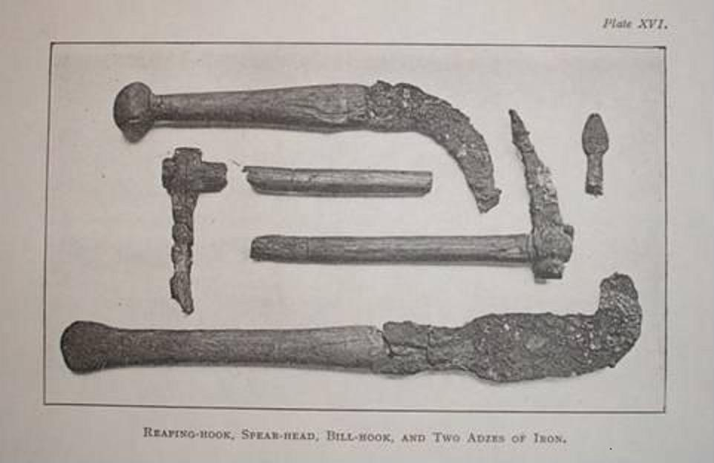
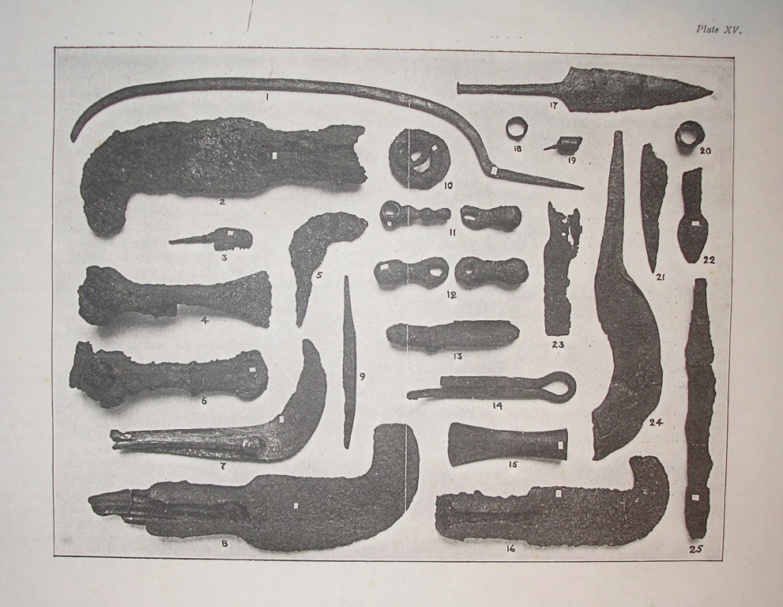
History 1
Iron Age Glastonbury Lake Villages, Somerset, UK

Slide 8
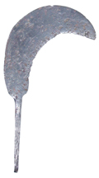
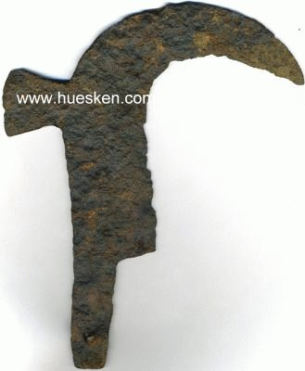
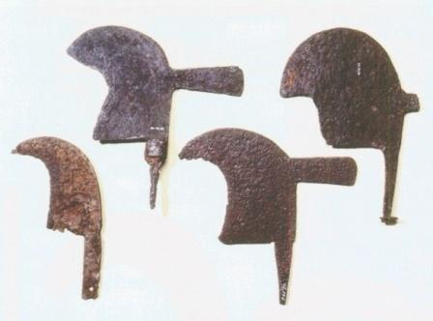
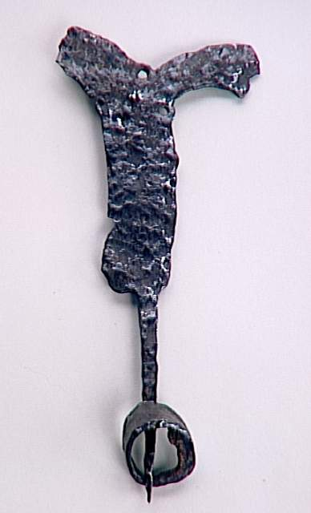
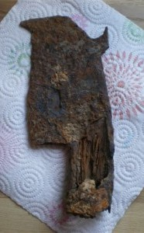
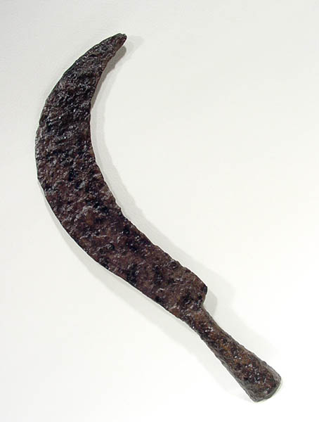
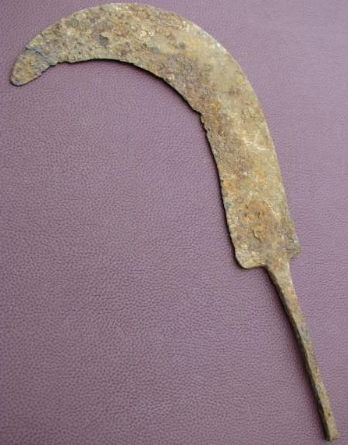
History 2
1st (Roman) to 11th century (Viking/Byzantine) Germany, UK, France and Balkans

Slide 9
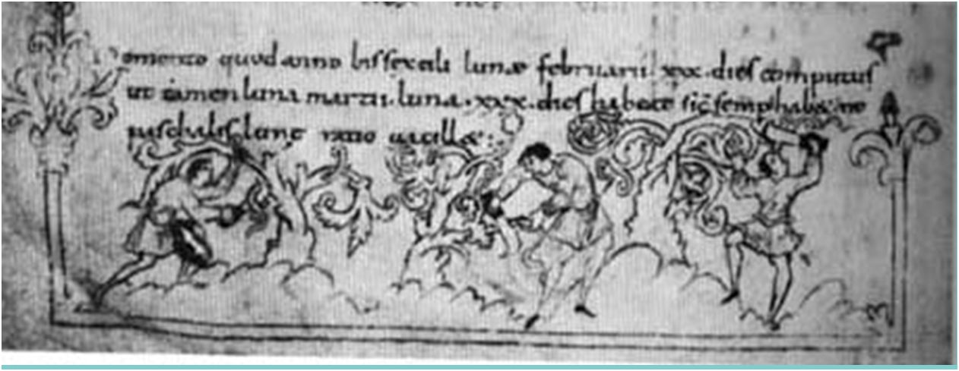
History 3
Anglo Saxon, early 11th century, Julius Work Book, Canterbury
Anglo Saxon, late 11th century, Tiberius Work Book, Winchester

Slide 10
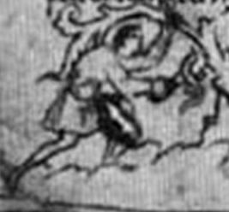
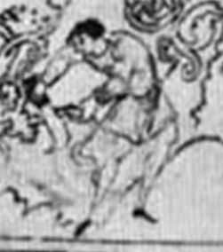
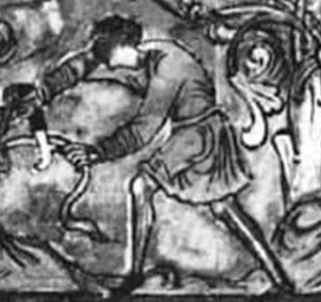
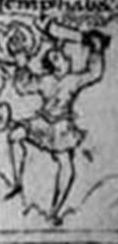
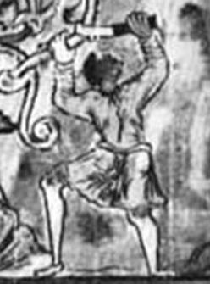
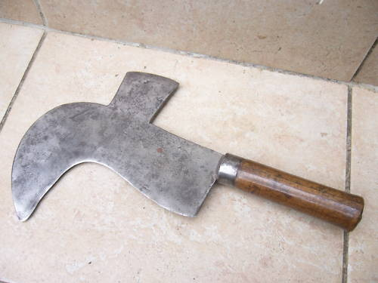
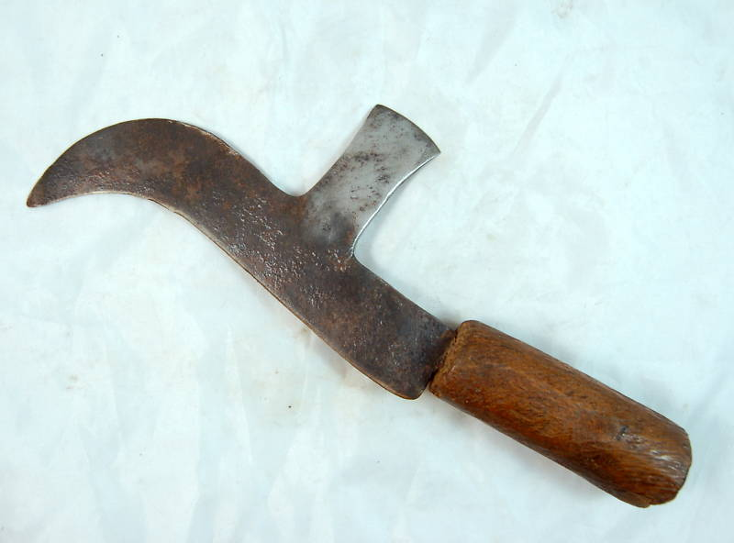
History 4
Details from Julius and Tiberius Calendars compared to modern French

Slide 11
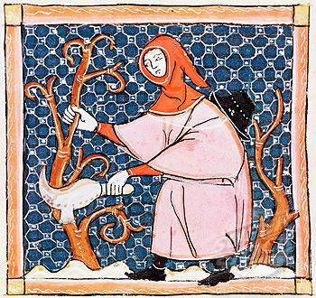
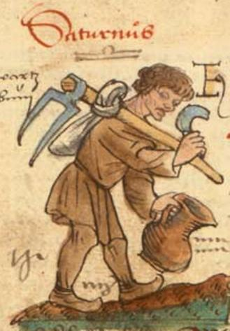
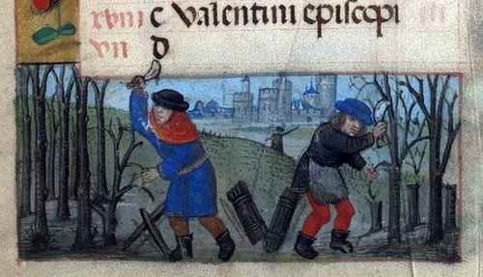
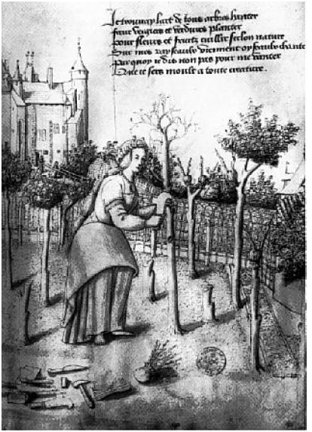
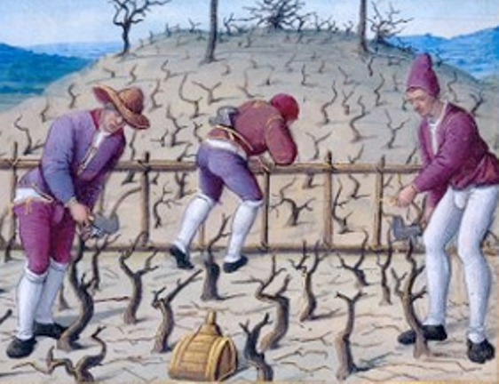
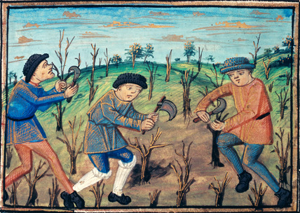
History 5
Other Medieval from 11th to 16th century from illuminated manuscripts and Books of Days (February and March – Vine Pruning

Slide 12
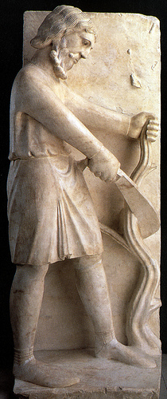
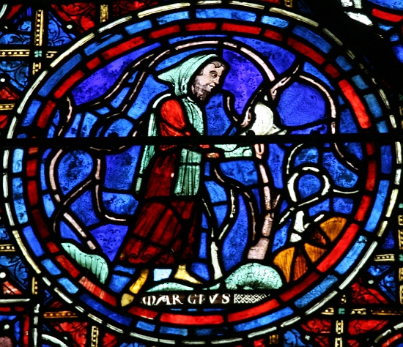
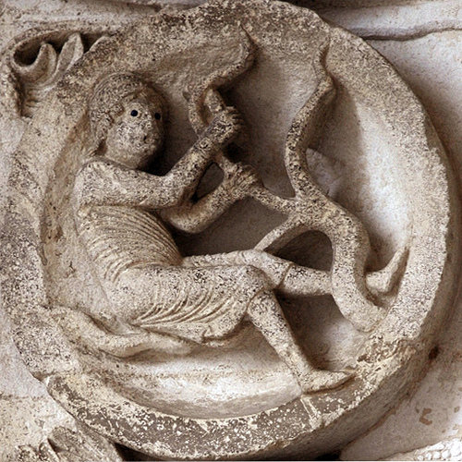
History 6
Stone and glass – cathedrals, gravestones, door lintels and boundary stones

Slide 13
What is a billhook used for??
An edge tool for cutting, trimming and cleaving green wood - used by hedge-layers, coppice workers, hurdle makers, thatching spar makers, basket makers and others
Until the mid 19th century it was the principal tool used for all aspects of pruning – so it was also a tool of the farmer, the gardener, the fruit-grower, viticulturist

Slide 14
Other bill hooks and bill-hooks…
Part of a knot tying mechanism, as found in a reaper binder or hay baler
A device for holding bills

Slide 15
Why is it called a billhook??
The Oxford English Dictionary states:
Bill-hook: (bi-l,huk) 1611 [f. bill sb.¹ ] A heavy thick knife or chopper with a hooked end, used for pruning etc.
Bill: (bil) sb.¹ [OE. bil = OS. bil, OHG bil (MHG. ; but G. bille fem., axe) :- WGme. bilja 1. A kind of sword mentioned in OE. poetry. 2. An obsolete weapon carried by soldiers and watchmen varying in form from a concave blade with a long handle, to a kind of concave axe with a spike at the back and its shaft ending in a spearhead; a halberd ME. 3. Short for BILLMAN 1495. 4. An implement having a long blade with a concave edge (cf. BILL-HOOK), used for pruning, cutting wood etc. OE. 5. A pickaxe - 1483.
The earliest known reference in the Oxford English Dictionary (OED), above, is 1611, and for a synonym, hook-bill, it is 1613. Shakespeare ca 1580 to 1600 used bill (Richard 111 1,4; Romeo and Juliet 1,1 & As you like it 1,2), and his less well known contemporary Sir Philip Sidney in ‘The Countess of Pembroke’s Arcadia’ ca 1580 also used bill; hedging bill and forest bill.

Slide 16
Continued.
Many, including Professor White in his scholarly work on roman agricultural tools, have erroneously stated that:
The term billhook indicates that the blades are ‘hooked’ (i.e. curved) in profile and that in addition they have the characteristic projection at the top of the curved blade, known as the ‘beak’ (Lat: rostrum, a bird’s beak).
While many billhooks are of this shape, others in the UK have straight blades (e.g. the Rodding or Block hook patterns) or even convex blades (e.g. Rutland or Hertfordshire patterns).

Slide 17
Continued..
Looking at the etymology of this using the world for billhook in other languages gives a different interpretation:
German: hackbeil (also hackmesser, haumesser, hippe, häpe, heep etc)
Dutch: hakbijl (also hakmes, snoeimes, etc)
Hook would thus appear to derive from hack (German) or hak (Dutch) and bill from beil (German) or bijl (Dutch) thus also giving some clues as to the origins of the invaders of Anglo Saxon Britain as well as the origin as of the name, hook-bill or billhook.
Bill thus does not refer to the shape of the tool resembling the beak or bill of a bird, and hook does not relate to the shape of the blade with a hooked end. Bill, beil or bijl thus go back to the OED definition giving its origin as axe or short sword. Hook, hack or hak also refer to the action of the tool for cutting or chopping. In German the word for the verb ‘to chop’ is hacken (noun hacke or hacker) and in Dutch it is hakken (noun hakker). The word for hook is haken (German) or haak (Dutch).
Thus billhook (or hook-bill c.f. hackbeil also spelled as hackebeil or hakbijl) describes the function of the tool as a chopping tool (sword, axe or short knife), rather than its ‘hooked’ shape (further confirmed by the alternative names of hackmesser (German) and hakmes (Dutch) where messer/mes means knife, hence chopping knife. In both languages (and also in Italian, Hungarian and Polish) the word for a billhook can also be synonymous with that for a meat cleaver.

Slide 18
Types of billhook
Single edged
Double edged

Slide 19
Handles – method of fixing
Socketed
Tanged
Rivetted Scales

Slide 20
Handle types and materials

Slide 21
Blade types (Single Edge)

Slide 22
Blade types (double edge)

Slide 23
Catalogue 1

Slide 24
Catalogue 2

Slide 25
Catalogue 3

Slide 26
Catalogue 4

Slide 27
Catalogue 5

Slide 28
Catalogue 6

Slide 29
Manufacture
Up to the early 20th century made with a wrought iron body and a steel cutting edge forge welded to it

Slide 30
Types of Edge Tool Forge
Hammer forge – relies upon the muscle power of the smith and his striker – still in use in 20th century – one off production
Water powered – use of a water wheel to drive a trip or tilt hammer – in Europe from 12th century – batch production
Steam powered – steam engine supplements or replaces the water wheel – from 19th century – division of labour – beginning of mass production – steam hammer, power hammer, spring hammer, Bradley hammer
Electric powered from – individual work station - early 20th century
Roller forging – gives shape to blade – increased productivity, reduced cost
Present day often cut from sheet steel rather than forged

Slide 31
Hammer Forge 1
Niclas Schweitzer (Nicolas the Swiss) died 18 June 1504
An edge tool maker and armourer from Nuremberg in Germany…
An inmate in an almshouse for retired craftsmen, one of two that took 12 brothers. The first set up my Konrad Mendel in 1388, the second by Matthew Landauer in 1511.
From 1425 until 1806 each brother had his portrait entered into the house-book, often with a portrayal of his craft.
Note the axe and cleaver to the right of his shop window..

Slide 32
Hammer Forge 2
Striker with the sledge hammer

Slide 33
Water Power
Water turbines
Types of water wheel

Slide 34
Trip and tilt hammers

Slide 36
Steam Hammers
In 1842 he visited the Le Creusot works in France and found his hammer in use there – upon his return to England he patented it
The steam hammer invented by James Nasmyth in 1838 to forge the crankshaft for Brunel’s Great Western – at first a free-fall (drop) hammer, later it was steam powered on the down stroke
The 100 ton steam hammer at Le Creuset

Slide 37
Mechanical Hammers

Slide 38
Roll Forging
Roll forging is quicker than hammer forging, and with shaped rolls stock bar or a pre-cut blank can not only be forged into the correct thickness but given the profile of the tool as well.
This method increased productivity and reduced costs, which lead to the decline and closure of smaller and outdated firms who relied upon hammer forging such as Fussell of Mells

Slide 40
Iron and steel 1
Iron ore was smelted in bloomeries (a type of small blast furnace) with charcoal as a fuel and limestone as a flux to produce a spongy mass of un-molten iron - approx 1 to 15kg bloom
Later blast furnaces completely melted the iron to produce pig iron (a crude form of cast iron) which is too hard and brittle for tools – it had to be re-worked in a finery or chafery to make it malleable
In 1709 Abraham Darby discovered coal could be used as a fuel if it was in the form of coke..
In 1784 Henry Cort patented a process where pig iron was re-melted in a reverbatory furnace with hammer scale to remove excess carbon
This process known as puddling produces wrought iron which is soft, tough and easily welded
Hammered into bars using a helve hammer which forces out the carbon and welds the iron together

Slide 41
Iron and Steel 2
Best Swedish wrought iron packed into boxes with charcoal and heated for several days or weeks to produce blister steel
Broken to lengths, head and welded to create shear steel, and best shear steel
Expensive so steel cutting edge welded to a wrought iron body
Still of uneven carbon content..
Benjamin Huntsman invented crucible process c 1740 to produce a homogenous steel for clock springs
Sheffield cutlers would not use it as it was too hard – he exported to France – finished cutlery then imported back to England – much to detriment of the Sheffield cutlers

Slide 42
Iron and Steel 3
High carbon steel 0.8% to 1.2% carbon
Henry Bessemer discovered a process c 1855 for the mass production of steel directly from pig iron by blowing air through molten pig iron and burning out the impurities
Cheap steel of consistent quality
Mild steel replaces wrought iron
Alloy steels with chromium, manganese, vanadium and nickel
Impurities in steel that can negatively affect its properties
Blades made of solid steel not welded

Slide 43
Heat Treatment
Iron and carbon combine to produce a metal with different properties to pure iron – we call this steel when below 2% - above this it becomes a cast iron – carbon also lowers the melting point
High carbon steels (0.8 to 1.2% carbon) can be hardened – but will be brittle
Heat to approx red heat and quench in oil or brine
Tempering reduces hardness, gives toughness
Range of tempering colours gives varying degrees of hardness and toughness
Approx 210 to 280º C

Slide 44
Phase diagram for steel 1
Iron and carbon combine to produce different phases at different temperatures
This depends upon the carbon content
Pure iron is called ferrite
Up to 0.8% carbon it becomes pearlite
Ferrite becomes austenite above 720ºC (this is known as the Critical Temperaure)
Austenite is non magnetic
Above 0.8% carbon excess carbon combines with pearlite to produce cementite
Quenching from above CT can ‘freeze’ the crystal structure to produce martensite

Slide 45
Phase diagram for steel 2

Slide 46
Forging and Tempering Colours

Slide 47
Forging iron and steel
Wrought iron is easily forged – it is tough and fibrous with a grain – it can easily be welded
Steels are more difficult to forge, heat control is critical
Generally forged at a lower temperature – require more force
Impurities such as sulphur can produce hot or cold short
Forge welding of wrought iron is relatively easy
Forge welding of iron to steel, or mild steel to high carbon steel is more difficult
Requires a flux, such as borax or silver sand (silica)

Slide 48
Forging Edge Tools 1

Slide 49
Forging Edge Tools 2
Plating – welding high carbon steel to wrought iron
Forging – thinning and initial shaping of blade
Stamping of blade with name, size etc
Drawing out of tang (or socket)
Cropping to shape (if required)
Initial grinding
Hardening and tempering
Sharpening and glazing (grinding on a wheel)
Fitting handle
Painting and transfers or label (often on the handle)
Wrapping in straw or card wool and packing in barrels

Slide 50
Grinding Shop 1
Grinding was a dangerous occupation, life expectancy was short
Dust from natural stones could cause silicosis
Stones could burst, often with fatal results
Sparks or metal fragments could cause eye injury
Spray of water from stones, working in damp and cold conditions could cause bronco-pneumonic disease, rheumatism etc
At least one cutler was drowned when the dam burst in the Great Sheffield Flood in 1864

Slide 51
Grinding Shop 2

Slide 52
Uses of a billhook
Coppice Work
Spar making
Hurdle making
Hedge laying
Pruning fruit trees and vines
Sharpening stakes
Snedding (forestry work)
Chopping (splitting) firewood
Clearing under-wood

Slide 53
Coppice Products 1
Bean poles (hazel)
Pea sticks (hazel or birch twigs)
Plant supports and stakes
Trellis work for gardens
Garden gates
Thatchers’ spars (or the gads they are cleaved from)
Woven and gate hurdles – previously used by shepherds for sheepfolds
Cleft chestnut or ash fencing
Fencing and fence posts (especially oak and sweet chestnut)
Charcoal
Cleft timbers for wattle and daub building
Cleft laths for plastering
Broom besoms
Wooden hoops for barrels (especially used for dry coopering)

Slide 54
Coppice Products 2
Chair legs and spindles (turned on pole lathes, especially in the region of High Wycombe Buckinghamshire – also wooden bowls)
Faggots for burning (especially in bread ovens)
Tool handles and hay-rakes (especially ash)
Baskets (but more commonly made from willow grown in wetlands)
Rustic furniture
Kindling wood and firewood
Roofing shingles, or shakes (cleft from oak in the UK)
Tent pegs
Clog soles (traditionally cut from alder)
Trugs and spale baskets
Walking sticks and shepherds’ crooks
Birch tops for constructing horse jumps (e.g. The Grand National at Aintree)
Green-wood furniture (e.g. Windsor type chairs)
Hedge laying stakes and binders

Slide 55
Other Hooks 1
A wide variety of hooks have been made and used, and by the end of the nineteenth century most manufacturers of edge tools included a range of products in their catalogues. Billhooks come under the heading of Light Edge Tools, and have been produced in the large industrial centres of 18th and 19th century England such as Birmingham (also Cannock and Wolverhampton) and Sheffield, as well as being made by smaller regional manufacturers such as Fussell of Mells; Nash of Stourbridge or Knapman of Totnes as well as by local blacksmiths, such as Buckland of Netheravon (Wilts) or Willis of Bramley (Hants). The range of tools offered by them was considerable and included:
Billhook: Also known as a Bill, Handbill or Hedging-bill - a medium duty curved hook with a blade length from 8” to 12” long, used for splitting and cutting of green wood up to about an inch and a half in diameter. Has been used in Britain and most other European countries for over 2000 years, and a wide range of regional patterns exist. It has been (and in some areas still is) used extensively for hedge laying, heavy pruning, hurdle making and many other coppice crafts. It is usually fitted with a caulked handle, but some patterns have a turned round or oval handle. Sometimes the blade is sharpened to a single bevel. The handle is most commonly fitted by a tang which passes through the handle, but some regional patterns have a socket for an inserted handle, or have wooden or leather scales riveted on.
Pruning Hook: A small, light hook used primarily by gardeners and horticulturists for the pruning of plants with a woody stem. Sometimes found with a shaft to the blade, similar to the gooseberry hook, or with a long extended handle. They were also made as a large pocket knife with a folding blade.
Vine Hook: No real equivalent in England – a very small hook used in France for cutting the bunches of grapes from the vine during the vendange or wine harvest. From the mid 19th century is has been superseded by the secateurs. It is often very similar to the basket maker’s hook (below).
Gentleman’s Hook: Also a smaller Lady’s Hook - a small billhook, often double edged, usually with a polished blade, brass ferrule and ornate hardwood handle.
Milton Hatchet: A version of a double edged gentleman’s’ hook, usually with a handle made with riveted horn or bone scales. The blade is much thicker than usual, and the rear blade is also unusual in that it only has a single bevel, similar to a carpenter’s chisel.
Gooseberry Hook: A small pruning hook with an extended shank to the blade to allow pruning of prickly bushes such as gooseberry. Similarly shaped tools were some times known as Raspberry Hooks.

Slide 56
Other Hooks 2
Blackberry or Bramble Hook: A larger version of the gooseberry hook, used for cutting back brambles.
Asparagus Knife: Some shapes of asparagus knives were similar in appearance to the gooseberry hook, although generally they had straighter blades. Many regions used a tool that was more like an elongated chisel or gouge, but some look like a narrow, elongated billhook.
Sheaf Knife: A small curved knife use by thrashers to removes the binding of the sheaf before feeding it into the thrashing machine. Often found with a hole in the handle for a loop of string to go around the wrist so that it would not drop into the machine when the sheaf was being separated. US makers produced a leather glove with a cutting blade attached.
Basket-maker’s Hook: A very small bill hook, with a blade about 3” to 4” long, used by basket makers for trimming the end of willow withies that stick out from the woven basket. Like the vine hook, it has now largely been superseded by the uses of secateurs.
Spar Hook or Spit Hook: A small billhook, usually between 6” and 7” long, used by spar makers for the splitting of hazel spars (or broches), used for securing the top layer of thatch to the undercoat. Occasionally spar makers used a hook sharpened on the outside edge. In France basket makers also split their willow or hazel using a wide variety of tools, including small billhooks (see above).
Block Hook: A billhook with a straight cutting edge, used for chopping onto a wooden block. The curved nose of a normal billhook would prevent the cutting edge making contact with the block. Used for splitting wood or trimming branches to the required length. Often with a hook, or spike on the back, to allow the user to pull the next piece within reach. The Knighton and Rodding patterns of English billhooks also had straight cutting edges, without the hooked nose, and most Dutch hooks and those from some parts of northern France and Belgium are similarly shaped.
Nobby Hook: A Dorset/Devon variation, similar in use to a block hook, but more like a square nosed bill hook, often made from a broken, or well worn, billhook. Sometimes known as a Trimming Hook. Used by hurdle makers for cutting the protruding ends of hazel gads at the outer edges of the hurdle, by chopping against a piece of wood held in the other hand. Straight edged billhooks such as the Knighton or Rodding Patterns were used for similar purposes.

Slide 57
Other Hooks 3
Broom Hook: A double edged billhook, with a straight cutting edge to the rear of the curved blade. Often used by the makers of besom brooms to trim the bunch of birch twigs to the correct length, in a similar fashion to the block hook, more common in the Midlands and parts of Wales. The Yorkshire billhook is similar, but has a longer, strapped handle. In France and other European countries the double edge billhook is common, often with a long narrow back blade, and was widely used in the vineyards for pruning old vines.
Furze or Gorse hook: A large, strong, curved billhook (Ireland) or a heavy sickle shaped tool (Devon) used for harvesting shrubby bushes such as gorse for use as animal fodder or bedding.
Bean or Pea Hook: A longish medium duty hook used in some areas for similar purposes as the furze hook. Also use for cutting down dry bean or pea plants for fodder after the harvest of the crop.
Sickle: A light harvesting hook, with a narrow tightly curved blade that opens out towards the point. Often with a serrated cutting edge, and used with a slicing or sawing movement.
Grass Hook: A light duty reap hook mainly used in domestic gardens, often with a sheet steel blade riveted or bolted to a steel shaft.
Reap or Rip Hook: A medium duty hook with a curved blade, heavier than the sickle, used for grass cutting and harvesting of corn. Used with a chopping motion.
Bagging or Fagging Hook: A heavier duty reap hook, with a wider blade, sometimes with a cranked or offset handle. OED defines to bag (or badge) as the cutting of corn (wheat) by hand. A bagging hook is thus a harvesting tool, with a heavier blade than a grass sickle or a reap hook. Fagging is probably a local dialect variation of bagging (possibly even a misprint) that has found its way into common usage.

Slide 58
Other Hooks 4
Gathering Hook: Not a cutting tool, but a hook used to gather the corn towards the harvester so it can be cut with the reap hook. Usually cut straight from the hedgerow, but sometimes a manufactured steel hook with a wooden handle. In some European countries a wooden finger-guard with a curved end is used.
Shearing Hook: Similar in appearance to a cranked bagging hook, but with a wider and slightly dished blade. It is a thatcher’s tool used on the backhand for levelling the surface of the thatch. It appears to be a left handed tool, but in use it used in the right hand, cutting from left to right, i.e. away from the thatcher and onto the finished section of roof.
Eaves Hook: A slightly curved hook, with a long blade, used by thatchers for trimming the under the eaves of a roof. Some counties used the straighter eaves knife, which is fitted to a long handle.
Ridge Hook or Thatcher’s Knife: Usually a thin, straight, or convex, blade used to produce the decorative pattern to the lower edges of the ridge of a thatched roof. Sometimes with a cranked, or offset, handle to prevent the knuckles contacting the rough ends of the straw.
Trimming or Staff Hook: A long handled socketed hook, with an open curved blade used for cutting back bushes and hedges.
Slasher: A heavier and stronger version of the trimming hook, sometimes with a straight, or convex blade, used for cutting the thicker stems of large bushes etc. The blade is usually fixed to the handle with riveted straps, sometimes reinforced with a steel ring or with an elongated oval socket. French versions, known as Croissants, are often crescent-moon shaped with a wide blade – heavier than the English Staff hook
Brush(ing) Hook: A medium duty trimming hook, used for cutting back dense undergrowth, overgrown hedges etc.

Slide 59
Other Hooks 5
Bush Knife (also Bank Knife): In the USA, South Africa and Australia a long handled slasher, similar to a heavy billhook strapped to an axe handle, was used for cutting of heavy undergrowth.
Osier Hook: In some parts of the UK a hook sharpened on the outside edge was use for harvesting osiers (willow) for basket making.
Hop Hook: For cutting the strings that held hops to the hop poles long handled hooks were used, consisting of a socketed blade similar to a small reap hook that was attached to a pole some 10 to 12 feet long. Often these also had a small hook projecting from the back of the blade that could be used in lowering the hop bine to the ground, or possibly also in the fixing of the network of strings that went from ground level to the tops of the poles for the hops to grow up.
Secateurs: The invention of the secateur for pruning led to the gradual decline of the pruning hook, particularly in France, where it was widely used for trimming grape vines. For a while a hybrid tool, the Serpe-Secateur, was manufactured – a pair of secateurs having a small billhook blade (sometimes an axe blade, or both axe and billhook) projecting from the rear of one or both cutting blades. Some versions were more like a billhook with a secateur blade added.
Machete or Cutlass: For colonial use a lightweight tool with a thin, broad blade was developed, ideal for cutting overhanging vegetation and able to be used for long periods at a time without fatigue (e.g. cutting trails through dense undergrowth). These were made in a wide range of shapes and sizes, some of which have a hooked end similar to a large billhook. These are sometimes similar in shape to the falx, a large curved sword used by the people from Dalmatia: one of the few weapons to strike fear into the heart of a roman soldier as its curved point was able to penetrate through the roman shield wall. Today many forms of machete and jungle knife are manufactured for military usage.
Cane Knife: For cutting sugar cane a wide variety of knives and hooks are used, some similar in style to the machete with thin flexible blades, and others very similar in shape to billhooks. Like the machete, these were made in large numbers and exported to the colonies.
Corn Knife: A long bladed, sometimes curved, knife used for cutting of corn (maize) mainly found in the USA. In the Balkans the billhook was often used for the same purpose.

Slide 60
Other Hooks 6
Pruning Chisel: For removing branches from trees that could not be easily reached, a wide variety of tools were made to be fitted to a long handle. Some were similar to a large socketed chisel that cut in an upwards direction, with a billhook blade on the side that cut on the pull stroke, and others were S shaped, with blades that cut in either direction (see Coup-gui, below).
Coup-Gui: a small curved billhook, often with a chisel blade and a hook, mounted on a long handle, used in France for removing the parasitic growth of mistletoe from fruit trees, also called an Emondoir – very similar tools are used in Central America and Africa for harvesting Cacao pods.
Coup-Pain: not strictly a billhook, but a type of sickle used for cutting bread. Many other french tools may also be found with blades similar to those of some types of billhooks – the Coup-marc used for cutting up the marc or residue from wine or cider presses usually has a long handle and may be similar to a slasher in shape. Sometimes an old blade is remounted in a shorter handle and used for other purposes, such as chopping kindling wood.
Tea knife: A small billhook used for pruning tea bushes in India and other areas.
Banana Knife: A small hooked knife used for cutting bunches of bananas from the plant.
Woodsman’s Pal: For some reason the billhook never became popular in the USA, although several manufacturers did offer them. However a combination tool (billhook, digging tool and machete), designated the LC-14-B, designed by Frederick Ehrsam (a Swiss émigré) in 1941 and manufactured by the Victor Tool Co. of Reading, PA, became the standard issue to US Marine Corps. During the Vietnam War it was known as a Type IV Survival Axe, the main component of the "Tool Kit, Survival, Type IV" issued as NSN 8465-973-4807 under specification MIL-S-8642C, and was manufactured by Frank & Warren, Inc. It is still made in several variations of size and type of handle by Pro Tool Industries of Boyertown, PA..
Fascine Knife: Although the billhook was not widely used in the USA, one version was often known as a fascine knife. This was used by the military for creating fascines and gabions out of brushwood (hurdle like structures), used to support earth embankments in gun positions. Later they were widely used for machine gun emplacements, and as in the French and UK armies, were issued as a tool to machine gun units in WWl.

Slide 61
Other Hooks 7
Game-keeper’s Friend: A multi-purpose tool combining billhook, axe, spade and machete in one compact format – presumably designed for the game-keeper to carry into the woods when managing the estate.
Combination hooks: Several English manufacturers offered combinations of billhook and hammer, with and without nail puller, and several French makers offered a combined billhook and letter punch for timber marking in place of the more usual tool that combined the punch with an axe blade. A combined billhook and large hammer head for driving in stakes for use in French vineyards is also sometimes seen.
Miscellaneous Tools: A wide range of other chopping and cutting tools can be found for harvesting a variety of crops, these include Beet Knives, used for topping and tailing of sugar beet and other varieties of mangolds or turnips grown as feed for livestock and Cabbage Knives, for cutting the thick woody stems of cabbages and sprouts; Lettuce Knives for trimming lettuces; Cotton Knives (USA) or just general pattern Field Knives. In France the ‘serpe à betterave’ is a billhook shaped beet knife with a thin blade. English beet knives often have a spike on the back (similar to a block hook), or sometimes on the front of the blade, used for picking the next beet from the pile… In India a billhook shaped tool with a tripod leg arrangement, used cutting edge uppermost, is used for removing the husk from coconuts and preparation of vegetables for cooking.
Other Hooks: Some other trades use hooked tools, similar in appearance to small billhooks for the cutting of soft sheet materials. Plumbers and glaziers use them for cutting lead or zinc sheet; saddlers and shoemakers used them for cutting leather; electricians for removing the insulation from cables; and they have been made for cutting flooring materials, such as linoleum. Often of a good quality, they are sometimes mistaken for pruning hooks, although it is possible manufacturers sold the same tool to different wholesalers for different uses………
Diderot’s Encyclopaedia shows a similar tool being used in 18th century French glassworks. In France tools that look like billhooks use in ostriculture, to harvest the oysters, but although the back blade is sharpened like that on a double edged billhook, the main hook is blunt.
Other Tools: Most makers of agricultural edge tools also made a wide range of other tools, including: meat cleavers; spades and shovels; blades for chaff and other cutters; block knives as used by clog makers; axes and adzes; chisels and hammers – most of which fall outside the subject matter of this talk

